Slide 1
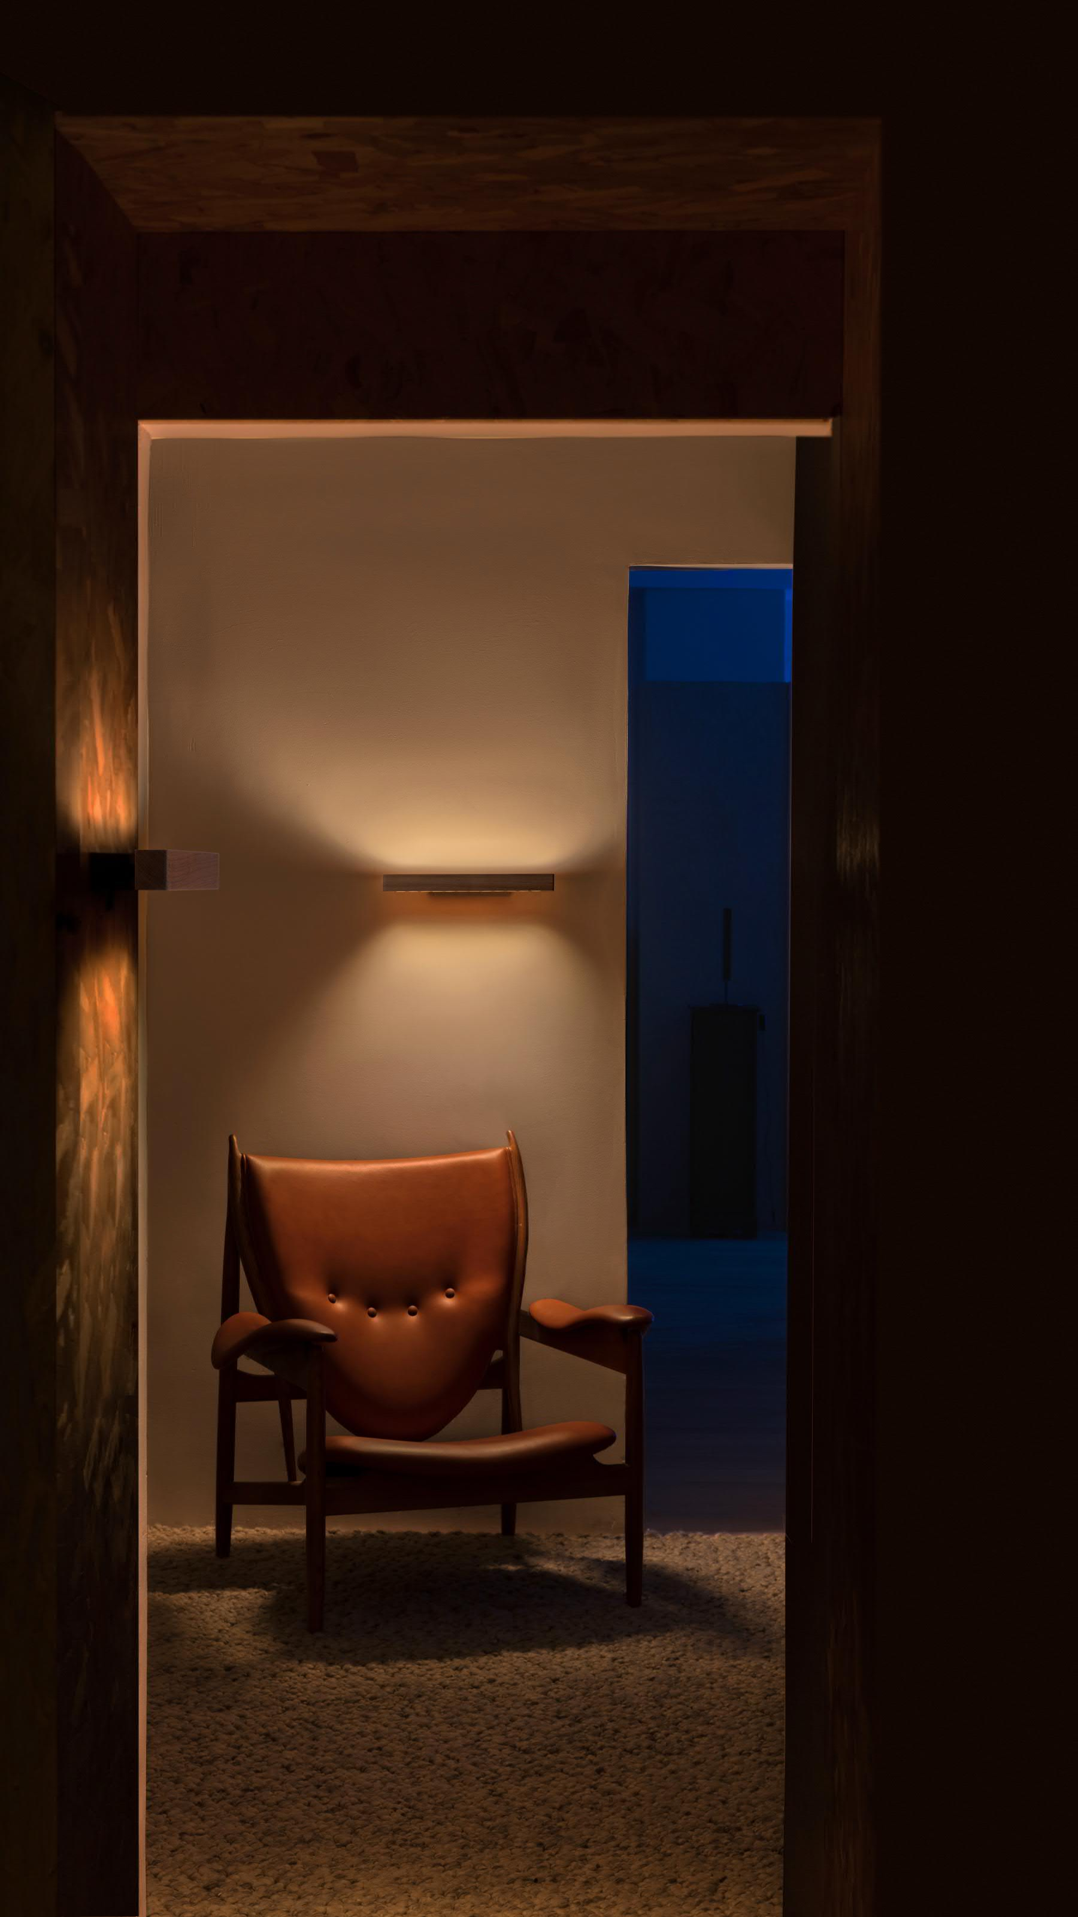
Lumatree Wall
A quiet solid-wood line. Two layers of light.
Notes:
[Sources]
- User-provided wall2.pptx; product photography and product specifications.
[/Sources]

Slide 2
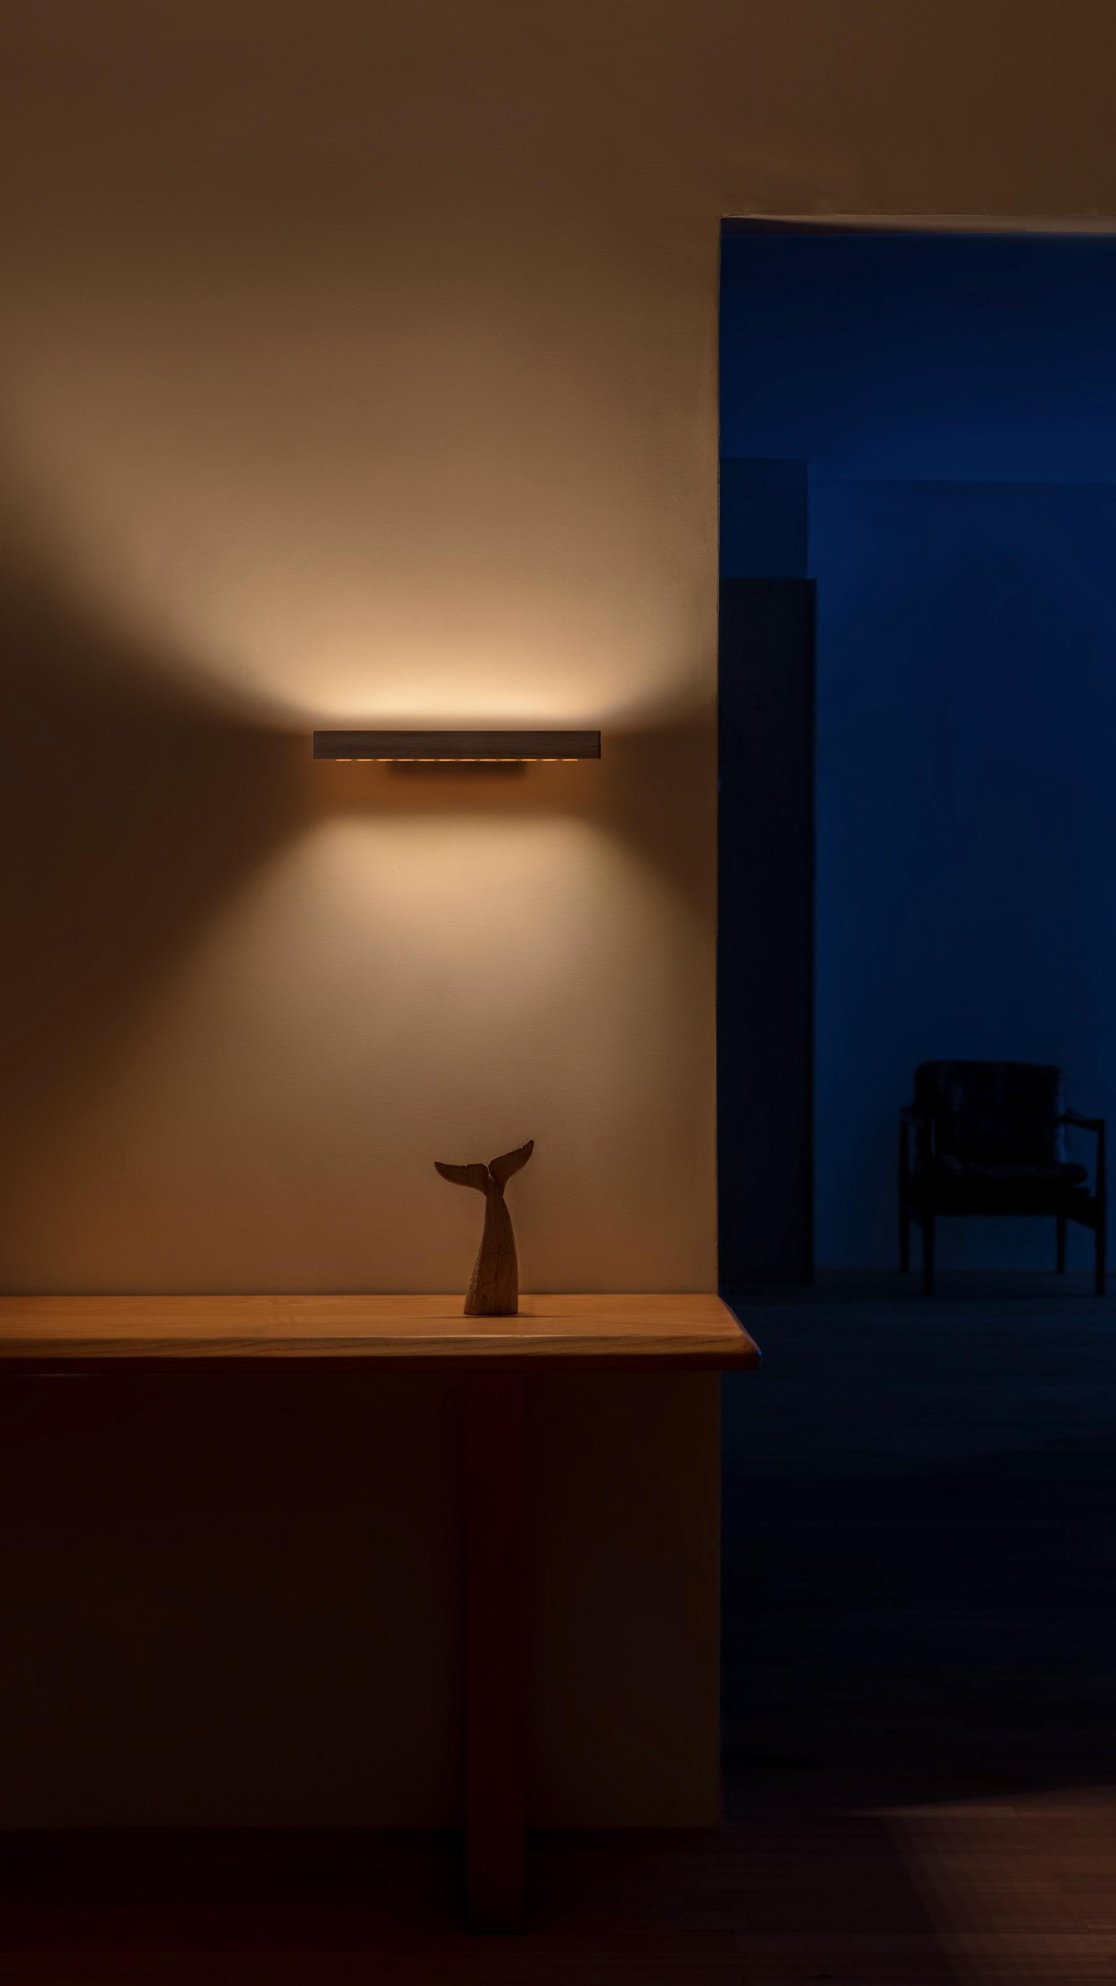
Atmosphere or function?
Wall delivers both.
Broad uplight shapes the room.
Controlled downlight supports the surface.
INDLEDs / Lumatree Wall
02
Notes:
[Sources]
- User-provided wall2.pptx; product photography and product specifications.
[/Sources]

Slide 3
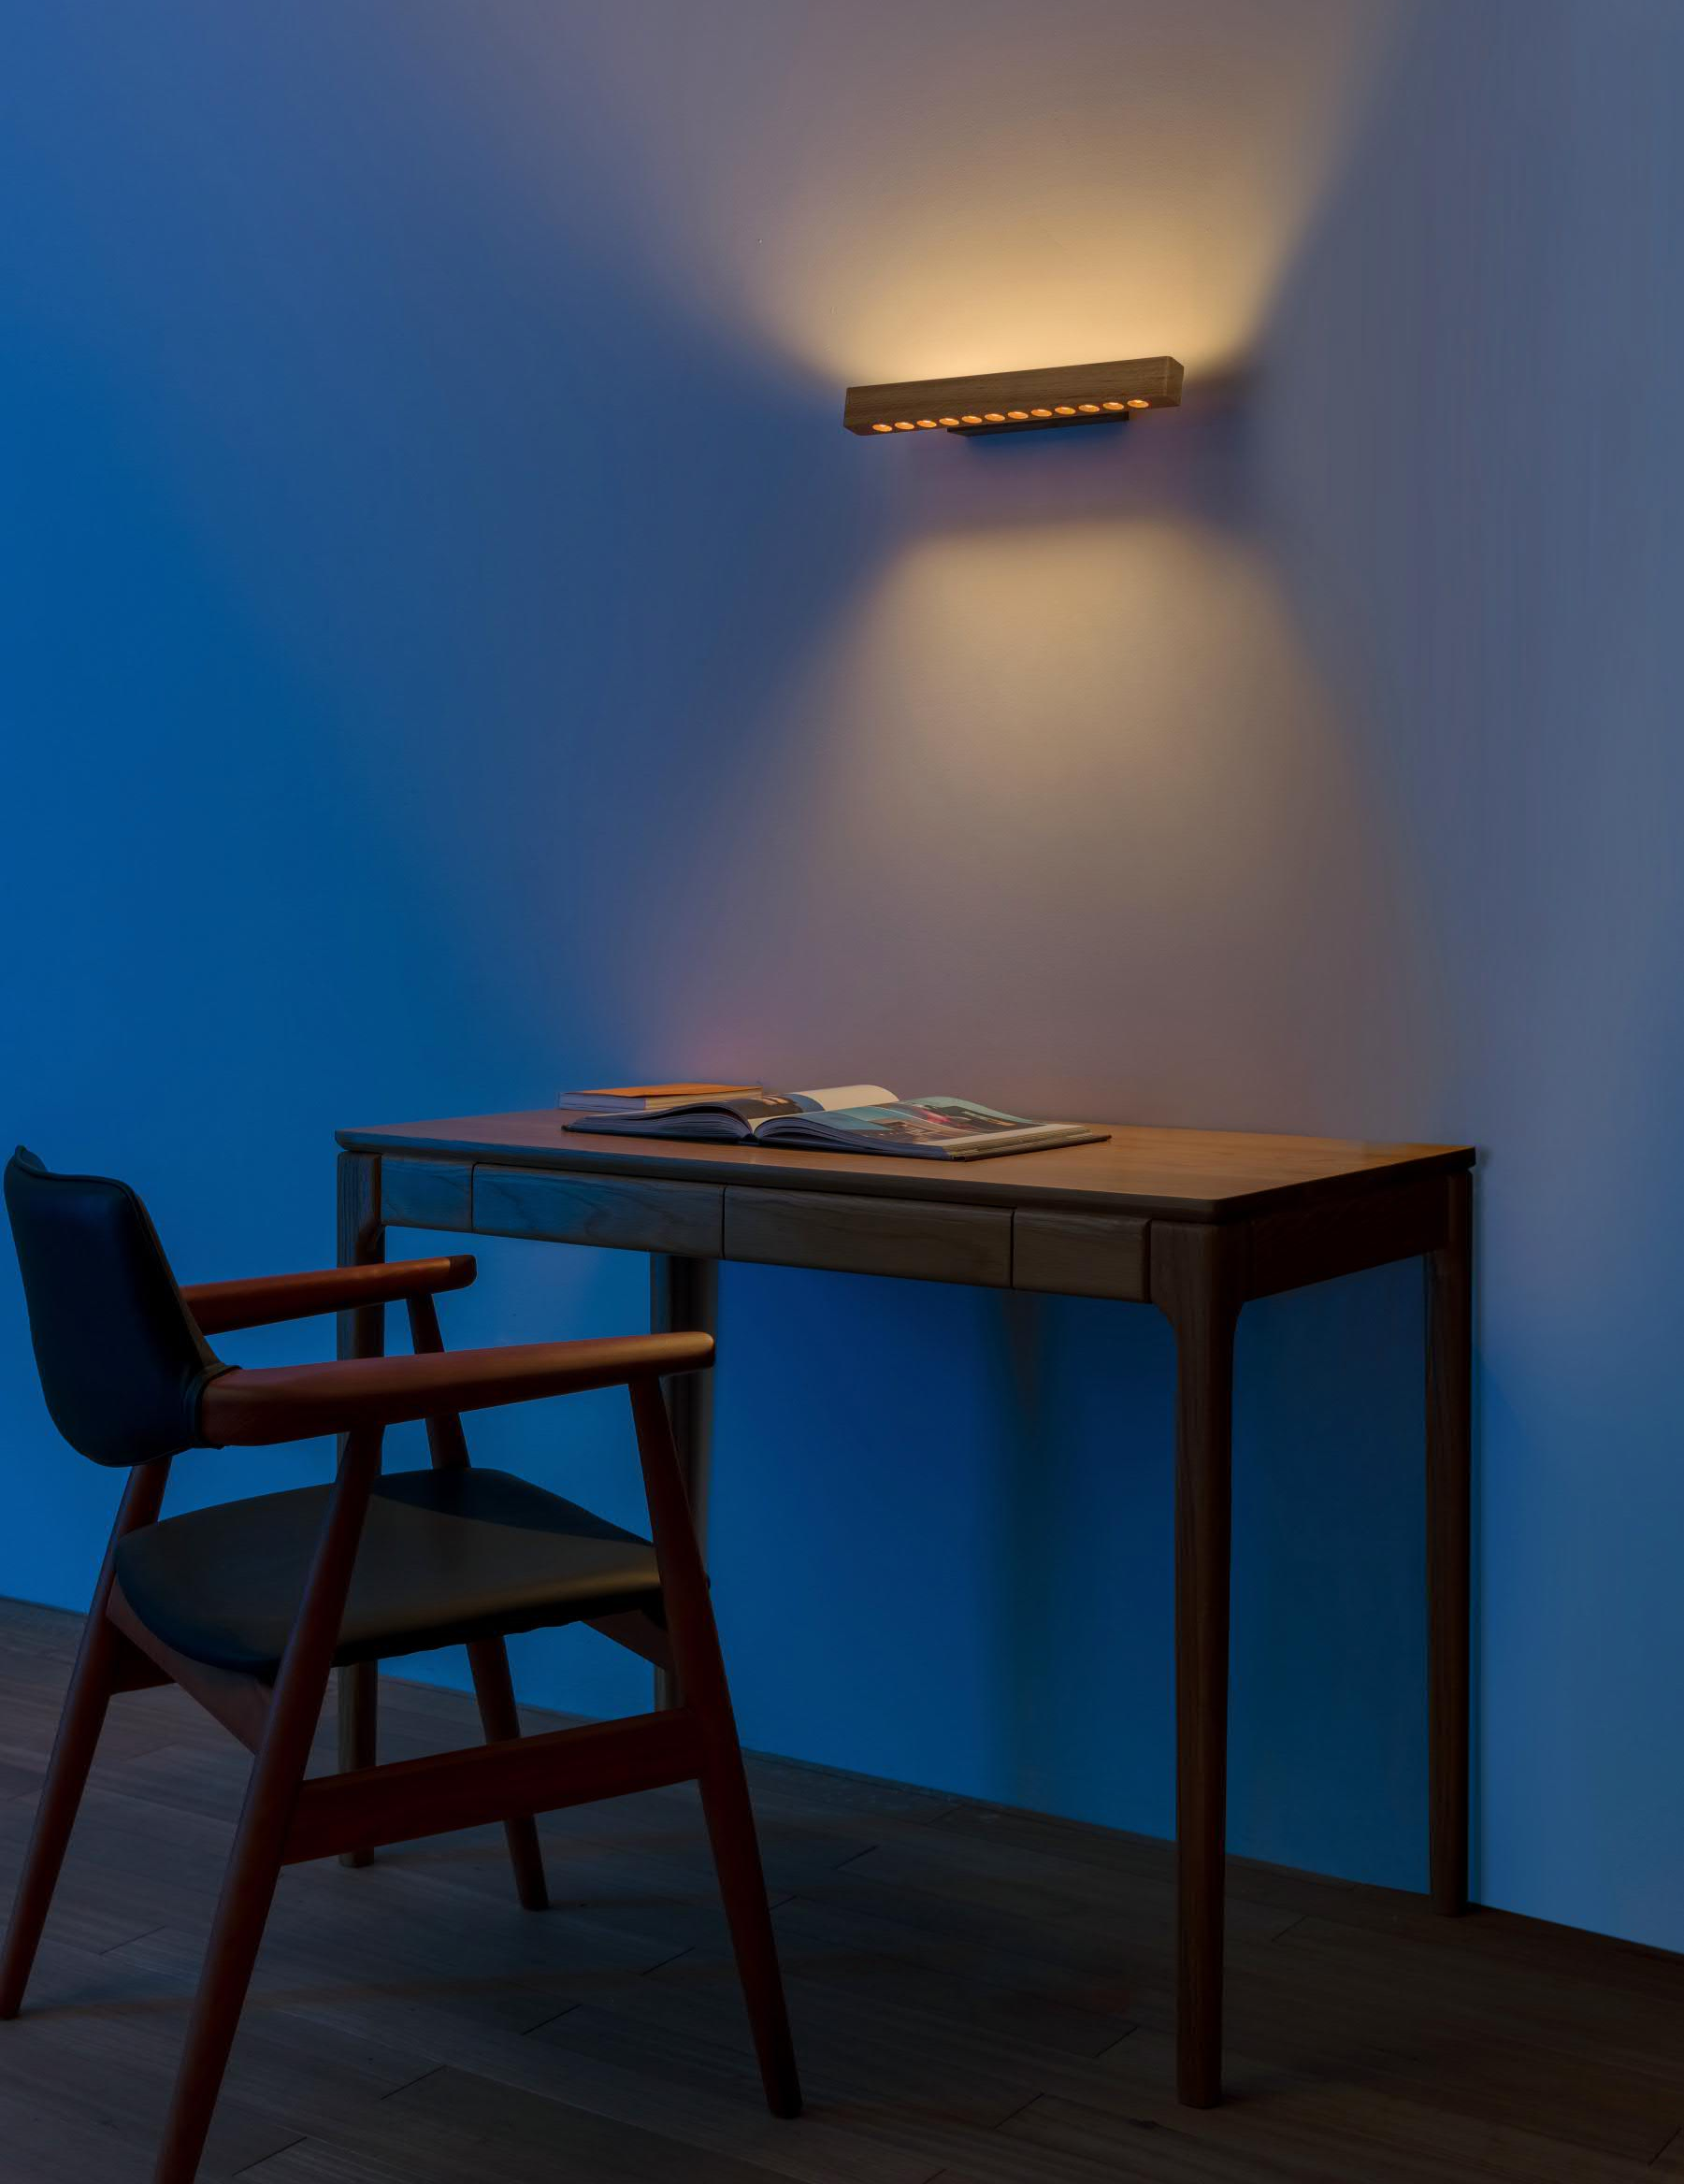
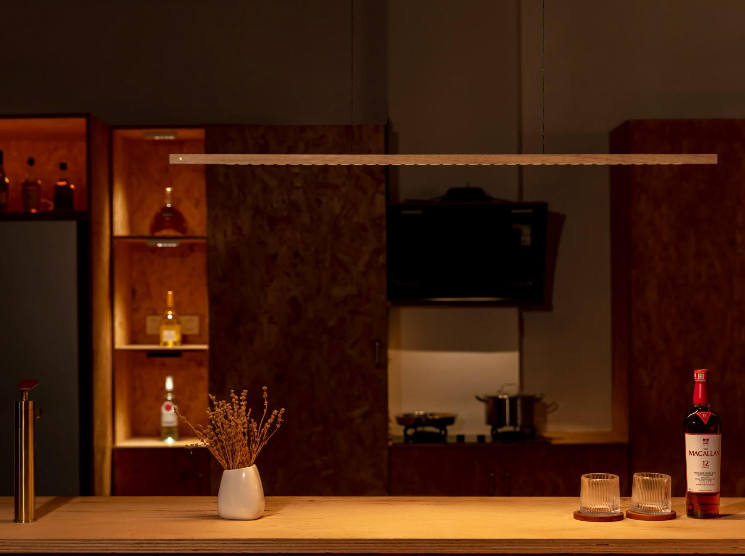
Soft across the wall.
Clear on the surface.
A 160° uplight builds ambient light above; the 64° downlight supports reading and work below.
INDLEDs / Lumatree Wall
03
Notes:
[Sources]
- User-provided wall2.pptx; product photography and product specifications.
[/Sources]

Slide 4
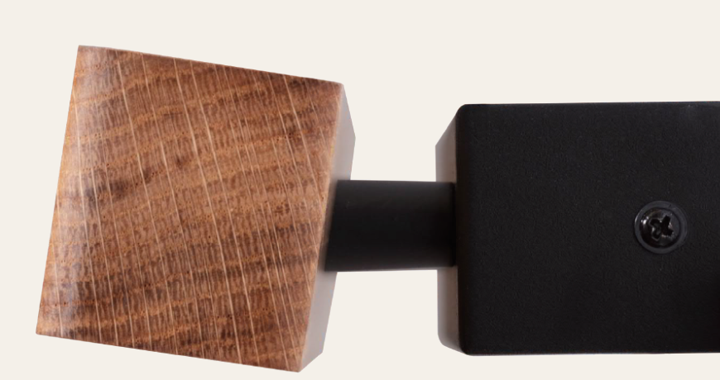
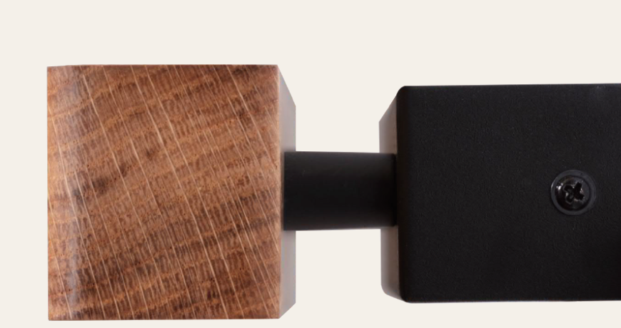
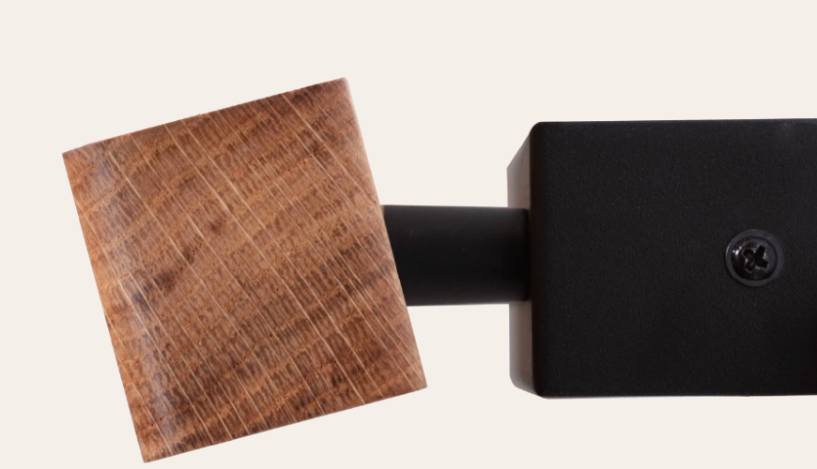
A slight tilt.
A better-balanced surface.
A small head adjustment redirects the 64° downlight across the desk or bedside—helping balance coverage while the recessed source stays out of normal view.
TILT UP
NEUTRAL
TILT DOWN
INDLEDs / Lumatree Wall
04
Notes:
[Sources]
- User-provided wall2.pptx; product photography and product specifications.
- User-provided cc83dc68-15f7-4263-a89a-32a261616d28.png; three product-head angle positions.
[/Sources]

Slide 5
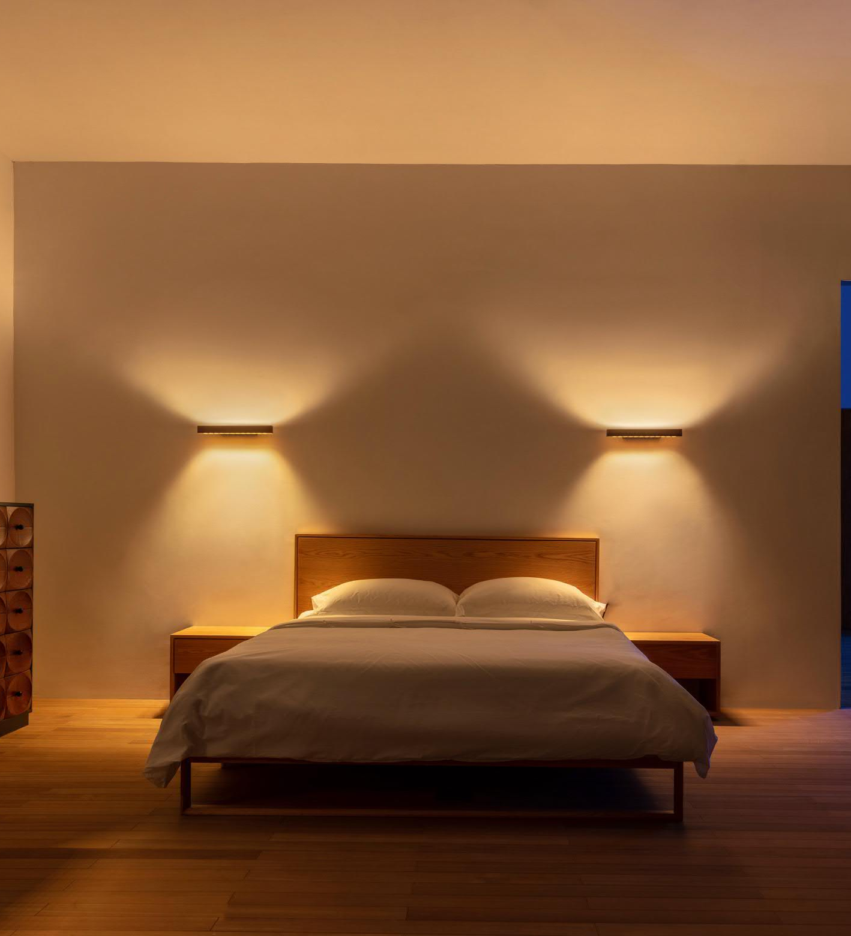
Mounted on the wall.
No table or floor footprint.
Both layers of light reach bedsides, desks and reading corners—without taking space from tables or the floor.
INDLEDs / Lumatree Wall
05
Notes:
[Sources]
- User-provided wall2.pptx; product photography and product specifications.
[/Sources]

Slide 6
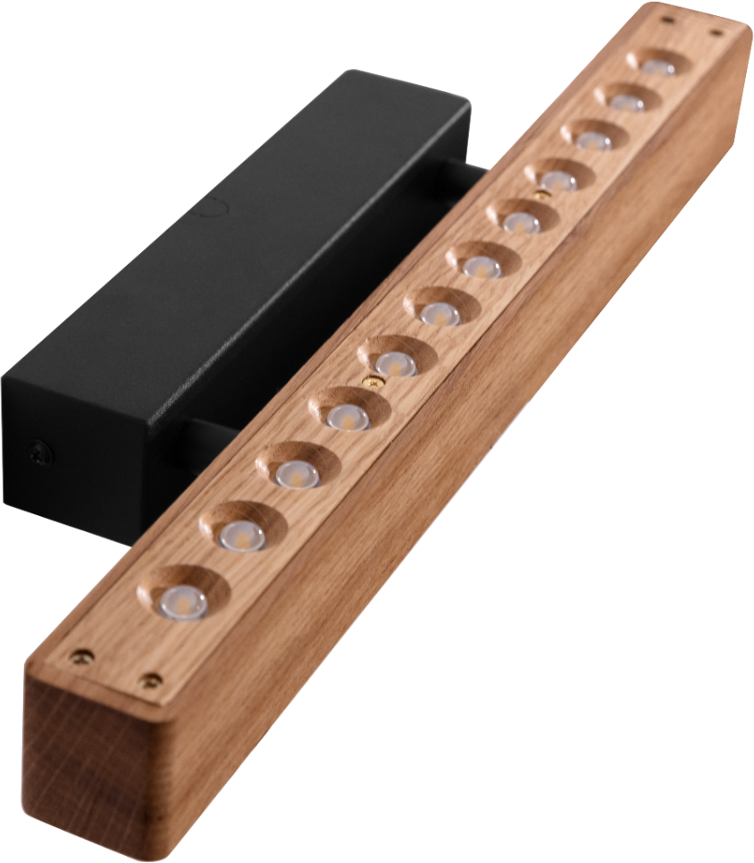
Broad light.
Recessed for comfort.
A nominal 160° uplight spreads broadly across the wall, while the 64° downlight supports the surface below. Both optics sit recessed within the solid-wood head, helping reduce direct view of the source from oblique angles.
INDLEDs / Lumatree Wall
06
Notes:
[Sources]
- User-provided wall2.pptx; product photography and product specifications.
[/Sources]

Slide 7
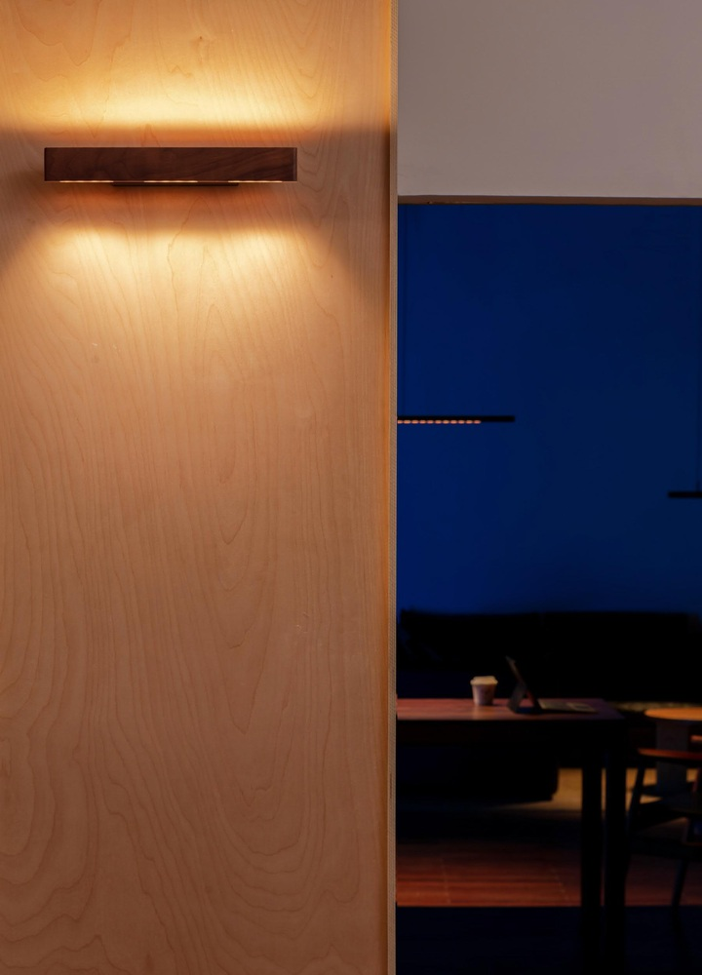
One family.
Across the room.
Wall shapes the vertical surface. Pendant brings light to the table. The same linear form and solid-wood identity connect different lighting roles within one interior.
INDLEDs / Lumatree Wall
07
Notes:
[Sources]
- User-provided wall2.pptx; product photography and product specifications.
[/Sources]

Slide 8
Ready to specify.
Light
Fixed white 2700K / 3000K
Dim-to-Warm 1800–4000K
Tunable white 2700–6500K
Output 1,740 lm total · 960 lm down / 780 lm up
Distribution 64° down / 160° up
Colour quality CRI 92
Control
Wired On/Off / TRIAC leading-edge / DALI
Wireless Casambi / Matter
Availability varies by configuration.
Material & finish
Solid wood Oak / Walnut / Black Ash
FSC-certified wood available on request.
Product, compliance & support
Dimensions Light bar 390 × 35 × 38 mm
Rear housing 200 × 32 × 38 mm
Wall projection 87 mm
Weight 0.85 kg
Electrical 12 W · 220–240 V · 50/60 Hz
Protection & compliance IP20 · CE
Project support 5-year warranty · IES / LDT / CAD / 3D on request
INDLEDs / Lumatree Wall
08
Notes:
[Sources]
- Wall dimensions, optical, control, material, electrical, protection and support values: user-supplied Wall presentation and user-confirmed family electrical/compliance information.
- Classification and formatting: user-approved Lumatree specification structure.
- Existing family-role pages are not repeated on the final specification page.
[/Sources]

