Slide 1
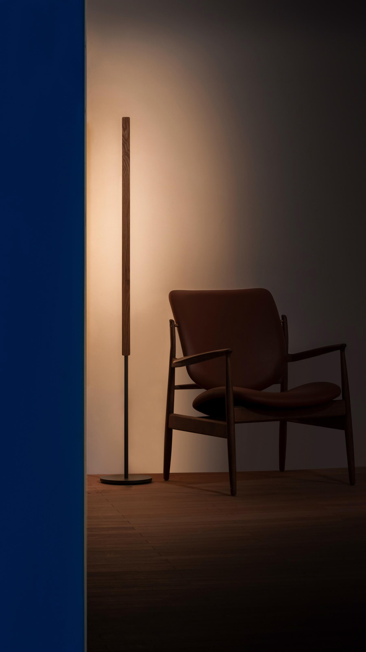
Lumatree Floor Wash
A quiet solid-wood line. The wall becomes the light.
Notes:
[Sources]
- User-supplied Lumatree Floor Wash20260523(4).pdf, page 1 (product and room photograph).
[/Sources]

Slide 2
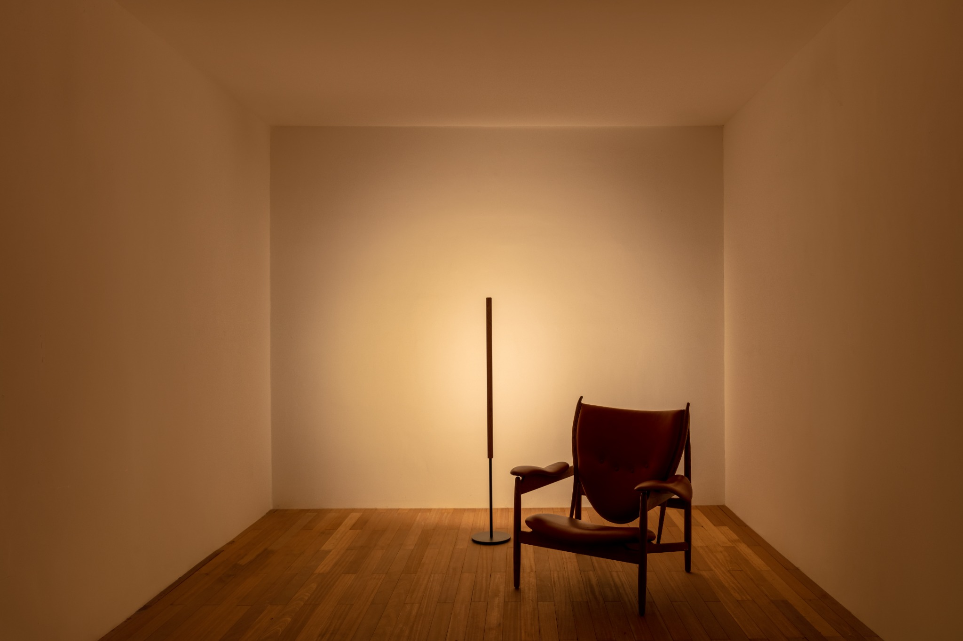
Most floor lamps glow.
Floor Wash lets the wall
do the lighting.
It lights the wall first—and the wall returns soft, reflected light to the room.
INDLEDs / Lumatree Floor Wash
02
Notes:
[Sources]
- User-provided warm Lumatree Floor Wash room photograph: upload/思勤光电26.5.64944-HDR.jpg; displayed in its complete 3:2 composition.
- Visible copy is an editorial refinement of the user-provided market-positioning language.
[/Sources]

Slide 3
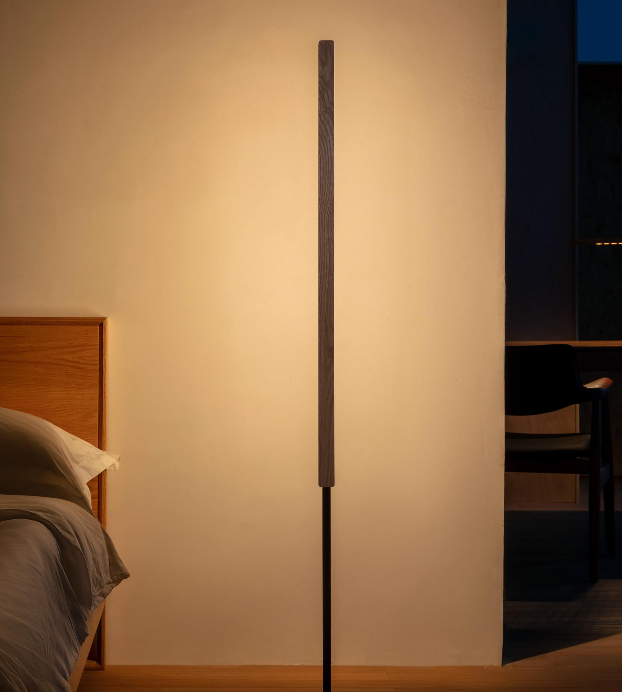
Bright on the wall.
Gentle at the bedside.
The illuminated wall keeps the room visually present around the bed and screen. Add Floor Task where page illumination is required.
INDLEDs / Lumatree Floor Wash
03
Notes:
[Sources]
- User-supplied bedroom photograph embedded in FLORWASH20260825(3).pptx.
- Visible copy distinguishes wall-based ambient light from page illumination provided by Floor Task.
[/Sources]

Slide 4
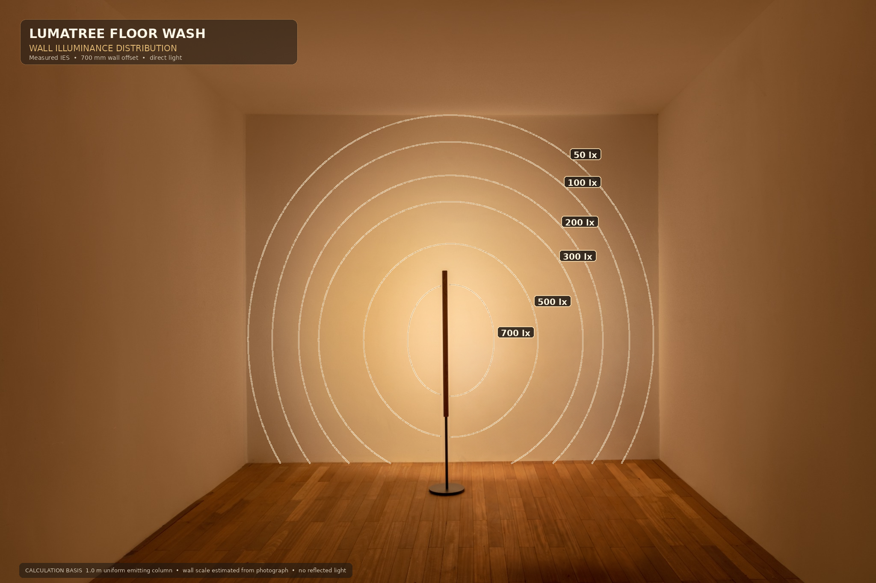
Broad coverage,
modelled on the wall.
Direct illuminance contours from measured IES photometry, modelled at a 700 mm horizontal offset. Reflected light is not included.
MODEL GEOMETRY
700 mm horizontal offset — optical face to finished wall
Direct illuminance contours: 50–700 lx · reflected light excluded
PLACEMENT GUIDANCE
Closer positions typically produce a narrower, brighter field; greater distance broadens the field and lowers wall illuminance. Light, matte walls return more light to the room; dark or absorbent finishes return less.
Request project-specific IES modelling for 200/400 mm offsets, coverage dimensions, or average/minimum illuminance targets.
INDLEDs / Lumatree Floor Wash
04
Notes:
[Sources]
- User-supplied wall illuminance visualization embedded in FLORWASH20260825(3).pptx.
- The embedded image states measured IES, 700 mm wall offset, direct light, no reflected light, and wall scale estimated from the photograph.
[/Sources]

Slide 5
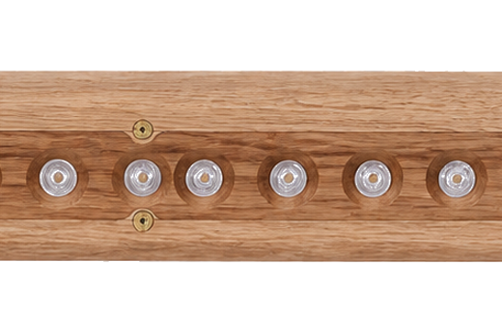
Wide on the wall.
Recessed from view.
A wide 160° distribution expands the wall wash, while recessed optics keep the bright source away from normal sightlines.
INDLEDs / Lumatree Floor Wash
05
Notes:
[Sources]
- User-supplied recessed-optics product close-up embedded in FLORWASH20260825.pptx.
- 160° distribution from the user-supplied Floor Wash specification.
[/Sources]

Slide 6
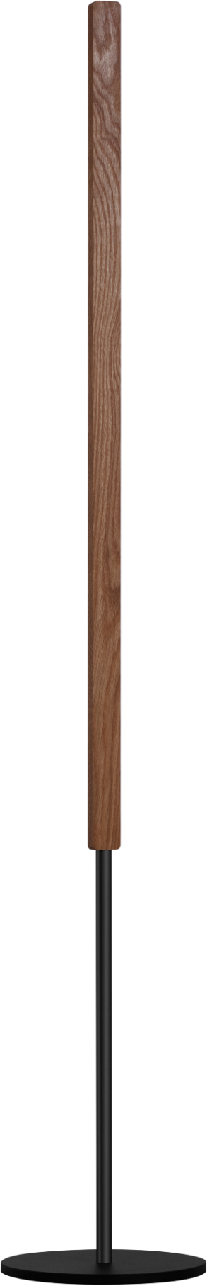
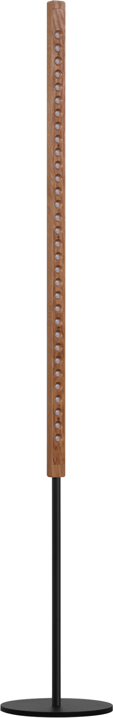
Simple in form.
Resolved in detail.
A slender solid-wood column, a stable weighted base, and carefully resolved junctions.
SOLID-WOOD FACE
RECESSED OPTICAL FACE
INDLEDs / Lumatree Floor Wash
06
Notes:
[Sources]
- User-provided product image: 思勤光电26.5.64727(1).png.
- User-provided product image: 思勤光电26.5.64731.png.
[/Sources]

Slide 7
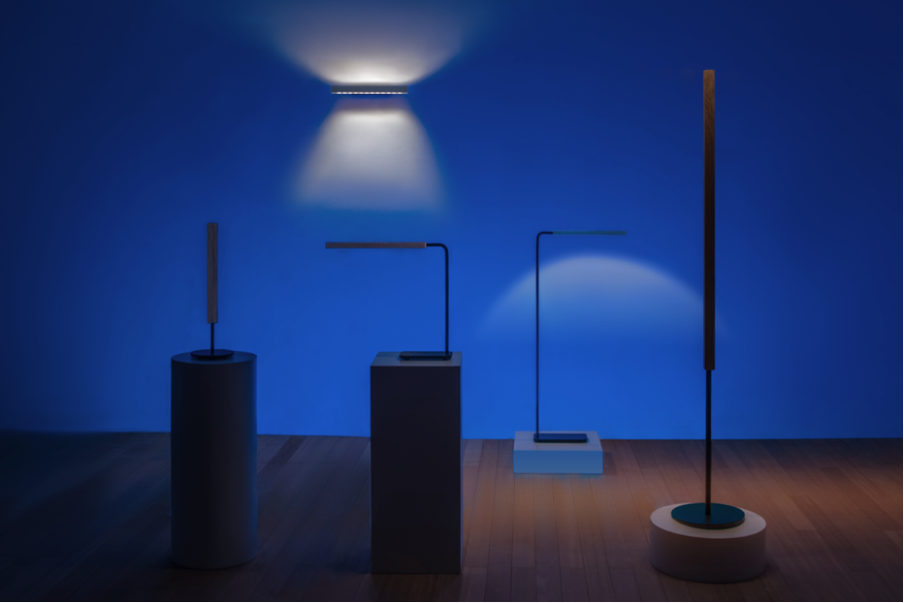
Same design language.
Six roles in the room.
SIX ROLES
PENDANT
Focused table light, with optional ambient uplight.
TABLE TASK
Broad, even task light across the working surface.
FLOOR TASK
Low, extended task light for seated reading.
WALL
Ambient uplight above; controlled surface light below.
TABLE WASH
Furniture-scale wall light from tables and shelves.
FLOOR WASH
Room-scale wall light from the floor.
INDLEDs / Lumatree Floor Wash
07
Notes:
[Sources]
- User-supplied Lumatree family image from 25fbf2ab-0132-4bc9-9da8-818a7c198c1a.png.
- Product-role descriptions use the user-established Lumatree family positioning.
[/Sources]

Slide 8
Ready to specify.
Light
Fixed white 2700K / 3000K / 4000K
Dim-to-Warm 2200–3000K
Output 3,380 lm
Distribution 160°
Colour quality CRI 92
Control
Local Touch dimmer
Wired DALI
Availability varies by configuration.
Material & finish
Solid wood Oak / Walnut / Black Ash
FSC-certified wood available on request.
Product, compliance & support
Dimensions H 1,542 mm · light column 1,025 mm · section 20 × 35 mm
Base & weight Ø250 mm · 5.6 kg
Electrical 26 W · 220–240 V · 50/60 Hz
Protection & compliance IP20 · CE
Project support 5-year warranty · IES / LDT / CAD / 3D on request
INDLEDs / Lumatree Floor Wash
08
Notes:
[Sources]
- Floor Wash dimensions, output, distribution, colour, control, material, electrical, protection and support values: user-supplied Lumatree Floor Wash presentation.
- Classification and formatting: user-supplied reference image 86e69155-c76e-4489-b4c4-e6afff1b7d91.png.
- Adjustment is omitted because it is not a Floor Wash feature; wall placement is already covered on slide 4.
[/Sources]

